Slide 1
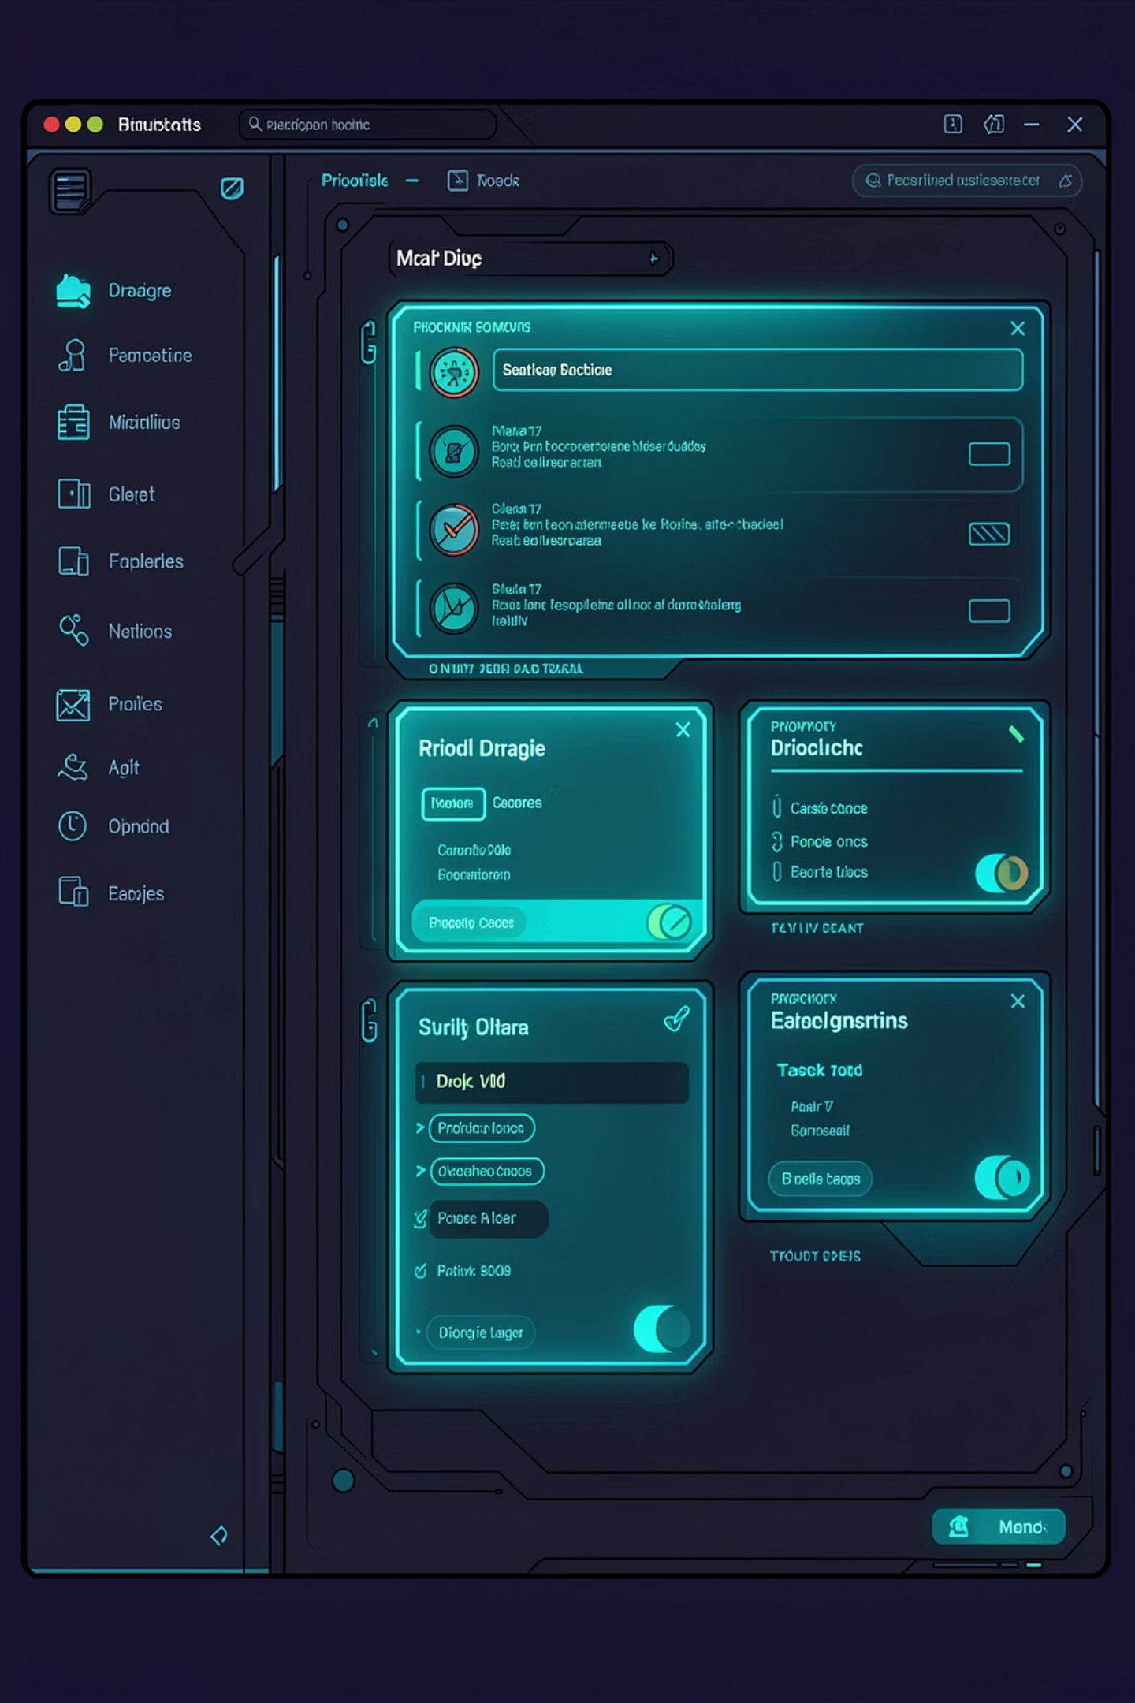
DATA STRUCTURES & ALGORITHMS PROJECT
TaskMatrix
A Priority-Driven Task Management System

Slide 2

The Vision Behind TaskMatrix
TaskMatrix is a desktop task management system built in C++ using SFML. It bridges the gap between raw task input and structured, priority-driven execution by leveraging core DSA concepts — Priority Queue, Linked List, and Stack — to manage, sort, and track tasks efficiently.

Slide 3
Problem → Solution
The Problem
The Solution
Managing tasks with varying urgency is chaotic. Manual tracking causes missed deadlines, forgotten tasks, and zero priority awareness.
TaskMatrix uses a Priority Queue, Linked List, and Stack to auto-sort, display, and track tasks — most urgent work always comes first.

Slide 4
The Engine Under the Hood
Frontend
Data Layer
Logic Layer
C++ with SFML 3.0 — rendering, UI, animations, event handling
File I/O with .txt persistence — tasks, daily tasks, completed history
STL Priority Queue, custom Linked List, Stack for task lifecycle management

Slide 5
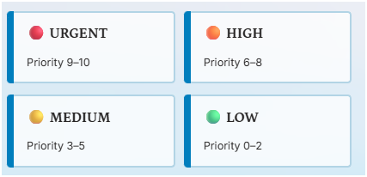
DATA STRUCTURE I
O(LOG N)
Priority Queue
Used to store and auto-sort tasks by urgency. Highest priority task always at the top. Custom TaskCompare comparator orders by integer value.
Priority Color Codes
Complexity
Insert
O(log N)
Get Top
O(1)
Remove
O(log N)
Load from File
O(N log N)

Slide 6
Data Structures II & III — Linked List & Stack
Linked List — Daily Tasks
Stack — Completed Tasks
Used for Daily Tasks. Each node stores title, date, status, completed flag, completedTime, and next pointer. Supports dynamic insertion and deletion.
Two stacks for completed tasks — one for Priority, one for Daily. Merged for display. LIFO order shows most recently completed first.
Add: O(N)
Remove: O(N)
Traverse: O(N)
Push: O(1)
Pop: O(1)
Peek: O(1)

Slide 7
TaskMatrix: System Flow
01
02
03
User adds task
Tasks saved to file
On relaunch
Stored in Priority Queue or Linked List
Via File I/O on every change
Tasks reloaded into data structures
04
05
Completing a task
Main Menu
Pushed onto Completed Stack
Shows live progress bar from both structures

Slide 8

File I/O — Persistent Storage
tasks.txt
daily_tasks.txt
completed_tasks.txt
Priority tasks: title, priority, date, completed flag
Linked list nodes: title, date, status, completed, time
Merged stacks with source tag

Slide 9
Visualizing TaskMatrix
Animated Background
Color-Coded Bars
Animated scrolling background (SFML sprites)
Color-coded task bars by priority level
Checkbox System
Daily Task Grid
Checkbox tick system for completion
Card-based daily task grid with status badges
Live Progress Bar
Exit Confirmation
Live progress bar on main menu
Exit confirmation popup

Slide 10
Thank You for Your Attention
Questions?
The Team
Known Limitations
Arhama Tariq: Priority Queue, File I/O.
Khaula Khalid: Daily Tasks Linked List, UI, SFML rendering.
Zara Sumbal: Completed Tasks, Counters.
No date validation
No edit functionality
File corruption risk if force-closed mid-write
// TASKMATRIX — BUILT WITH C++ & SFML

